Slide 1
TE 271: Analog Communication Systems Examiner: M. S. Ellis, PhD smellis.coe@knust.edu.gh 057 904 7591
September 13th , 2016

Slide 2
Syllabus
EM Spectrum: Impact of Visible light, infrared, x-rays on industry (Agriculture, Health,… etc.)
Carrier transmission
Spectrum translation (SSB, DSB)
Amplitude Modulation and Angle Modulation
Comparison of Modulation techniques
Power calculation
Pulse Modulation techniques
Sampling theorem

Slide 3
Reference material
A. Yadav, “Analog Communication Systems”, University Science Press, New Delhi, 2008.
S. Sharma, “Communication Engineering”, First Ed., S.K. Kataria & Sons, New Delhi, 2011.
T. G. Thomas, “Analog Communication”, McGraw hill, New Delhi, 2007.

Slide 4
EM Field Spectrum & Industry applications
The Electromagnetic (EM) spectrum is the range of all types of EM radiation
These radiations includes the light that comes from a lamp in homes/offices, and the waves that heat food in microwave ovens, among several others
The EM spectrum with its corresponding wavelengths & applications is shown below

Slide 5
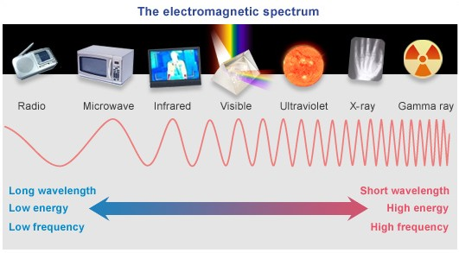
EM spectrum & applications
Radio Waves: AM radio, FM radio, TV
Microwaves: Microwave Ovens, WiFi
Infrared: Remote controls, Night vision goggles, security cameras
Visible light: Lights that our eyes detect including: fireflies, light bulbs
UV light: Used to detect forged bank notes, synthesis of Vitamin D
X-ray: X-ray scans, bone fracture detections
Gamma Ray: Cancer treatment, treatment of mutated cells
ASSIGNMENT 1
List the various frequencies and applications under Radio Waves

Slide 6
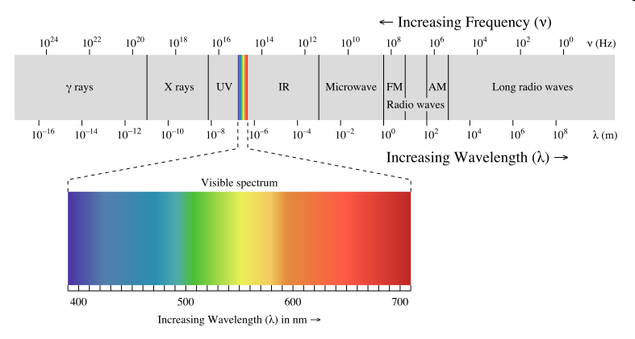
EM spectrum & applications…visible light
Research conducted by Japanese researchers (Tohoko University) described that certain wavelengths of visible light (typically blue light) are lethal to certain species of insects (fruit fly pupae, mosquitoes)
If successful conclusion is reached, this will help reduce to use of insecticides which are detrimental to human health and expensive in controlling large areas (farms)

Slide 7
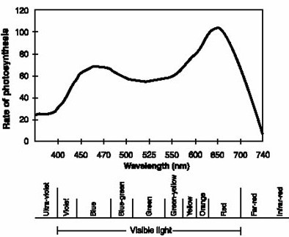
EM spectrum & applications…Visible light…
The rate of photosynthesis peaks around 450 nm (blue light) and 650 nm (red light)

Slide 8
Intro to Basic Comm. Systems
Process of conveying (sending, receiving and processing) information at a distance is termed communication
Communications can happen through open space, satellites and optical fibres
Communication usually occurs in the relatively low energy part of the EM spectrum

Slide 9
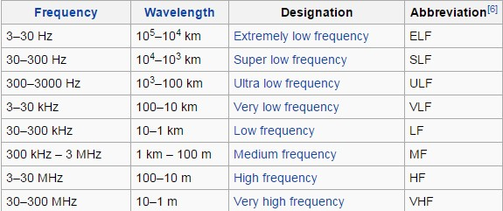
Intro to Basic Comm. Systems….
The frequency range for various types of communications is tabulated below
It’s worth to note that these frequencies do not include the “light part” of the EM spectrum

Slide 10
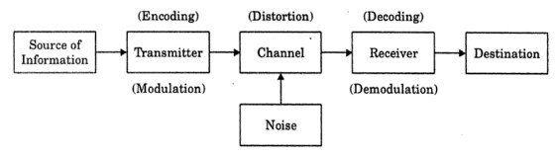
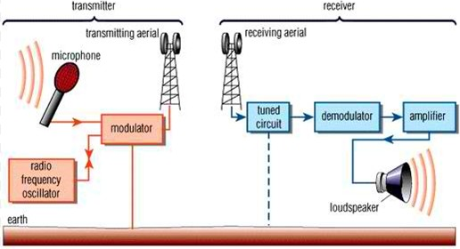
Intro to Basic Comm. Systems….Elements of communication systems
Source of information may be sound, video, data.
Transmitter processes the physical message before propagation. Processes involve modulation and amplification
Channel is the media through which the signals travel from the transmitter to the receiver. The medium could be free space, optical fibre or wire
The receiver reverses the process of the transmitter. Converts the incoming signal back to its physical form, through a process called demodulation

Slide 11
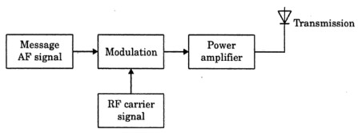
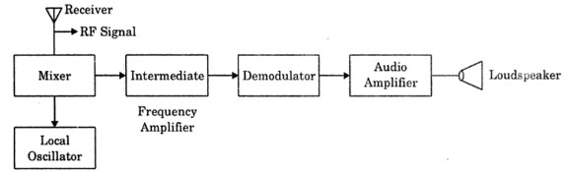
Simplified Transmitter block diagram
Simplified Receiver block diagram

